Slide 1

ABHAY KUMAR
REGISTRATION NUMBER : (42310001)
ROLL NUMBER : (22S315008)
M.E : (CSE)

Slide 2
PROJECT TITLE:
HEART DISEASE PERDICATION USING MACHINE LEARNING ALGORITHMS:

Slide 3
Presentation Outline
Abstract
Introduction
Domain
Literature Survey
Methodology
Application
System Architecture
Architecture Of Predication System
System Configuration
Machine Learning
Machine Learning Algorithms
Predication Of Disease
Data Set Details
Example Of Confusion For Matrix Accuracy (Performance Analysis)
Machine Learning Algorithms Performance Analysis Results (1) Svm 2) Knn 3) Random Forest 4) Xg-Boost 5) Ada-Boost) 6) ANN 7) DNN 8) Linear Regression 9) Logistic Regression 10) Naïve Bayes 11) Decision tree
Coadding And Testing
Simple Code
Results From The Test Data Set
Results And Discussion: Input And Output GUI
Results
Conclusion And Future Work
References

Slide 4

Abstract:
Heart is one of the most important part of the human body. It helps to purify and circulate blood to all parts of the human body. Most millions of number deaths in the world are due to Heart Diseases. Some symptoms like chest pain, faster heartbeat, discomfort in breathing, are recorded in medical history. This all data will be analyzed on regular basis of heart disease. In this Research review an overview of the heart disease and its current modern procedures is firstly introduced. an in-depth analysis of the most relevant machine learning techniques available on the literatures for heart disease prediction is briefly elaborated. The discussed machine learning algorithms are Decision Tree, SVM, ANN, Naive Bayes, Random Forest, KNN.DNN XG-BOOST,ADA-BOOST The algorithms are compared based on features. We are working on the algorithm with best accuracy Results. This will be helping the doctors to assist the heart patient's problem easily.

Slide 5
Introduction:
Heart disease is the kind of disease which can be cause the death. Every year too many peoples are dying due to heart Attack diseases. Heart disease can be occurred due to the weakening of heart muscles cells. Also, the heart failure can be described as the failure of heart to pump the blood in human artery. Heart diseases is also known as coronary artery disease (CAD).means CAD can be occurred due to insufficient blood supply to body arteries parts. Heart disease can be detected using some symptoms like high blood pressure, chest pain, hypertension, cardiac arrest, discomfort in breathing etc. There are many types of heart diseases with different types of symptoms are recorded . Like: 1) heart disease in blood vessels: chest pain, shortness of breath, 2)heart disease caused by abnormally heartbeats :slow heartbeat, discomfort in breathing, chest pain etc. Most common symptoms are recorded chest pain, shortness of breathed. Most common symptoms are chest pain, shortness of breath, fainting are reordered due to heart disease patients. Causes of heart disease are defects you’re born with, high blood pressure, diabetes, smoking, drugs, alcohol. Sometimes in heart disease the infection also which affects the inner membrane artery which is identified by symptoms like high fever, fatigue, dry cough, skin rashes. Causes of heart infection are bacteria, viruses, parasites and parasitism. Types of heart disease: Cardiac arrest, Hypertension, Coronary artery disease, Heart failure, Heart infection, Congenital heart disease, Slow heartbeat, Stroke this type heart disease are recorded in medical history, ang. Now a present days there are so many automated techniques to detect the heart disease like data mining, machine learning, deep learning, etc. So, in this paper review we will be brief introduction about machine learning techniques. In this we train and test the datasets using the machine learning repositories. There are so many risk factors on the basis of that the heart disease are predicted. Risk factors are like Age, Sex, Blood pressure, Cholesterol level, Family history of coronary illness, Diabetes, Smoking, Alcohol, Being overweight, Heart rate, Chest Pain etc.

Slide 6
Different types of heart disease:
Arrhythmia | The heartbeat is improper whether it may irregular, too slow or too fast.
Cardiac arrest | An unexpected loss of heart failure function, consciousness and Shortness of breath occur suddenly.
Congestive heart failure | The heart does not pump blood as well as human artery it should be, it is the condition of chronic.
Congenital heart disease | The heart’s abnormally which develops before birth.
Coronary artery disease | The heart’s major blood vessels can be Damage, or any disease can be occurring in the blood vessels.
High Blood Pressure | It has been a condition that the force of the blood against the artery walls is too high.
Peripheral artery disease | The narrowed blood vessels which can be reduce flow of blood in the limbs, is the circulatory condition.
Stroke | Interruption of blood supply or occur damage to the brain.

Slide 7

Domain:
Machine Learning:
Machine Learning is the art and science of enabling machine to learn things Which are not explicitly programmed.
Python is Widely used general-purpose, high-level Programming Language.
Python Is a Programming Language that lets you work quickly and integrate Systems more efficiency.
Python Can be used Windows, Mac, Linux, etc.

Slide 8
Literature Survey:
YEAR | AUTHOR | PURPOSE | TECHNIQUES USED | ACCURACY
2015 | Sharma Purushottam et al,[15] | Efficient Heart Disease Prediction System using Decision Tree. | Decision tree classifie | 86.3% for testing phase. 87.3% for training phase
2015 | Boshra Brahmi et al, [20] | Prediction and Diagnosis of Heart Disease by Data Mining Techniques. | J48, Naïve Bayes, KNN, SMO | J48 gives better accuracy than other three technique
2015 | Sairabi H. Mujawar et al, [24] | Prediction of Heart Disease using Modified K-means and by using | Modified k-means algorithm, naive bayes algorithm. | Heart Disease detection=93%. Heart Disease
2015 | Noura Ajam et al, [21] | Heart Disease Diagnoses using Artificial Neural Network. | ANN | 88%
2016 | Prajakta Ghadge et al, [22] | Intelligent Heart Disease Prediction System using | Hadoop, Mahout, Naïve bayes. | The automation of this system makes extremely
2017 | P. Sai Chandrasekhar Reddy et al, [17] | Heart disease prediction using ANN algorithm in data mining. | ANN | Accuracy proved in JAVA.
2017 | Jayami Patel et al,[14] | Heart disease Prediction using Machine Learning and Data mining Technique. | LMT, UCI | UCI gives better accuracy, compared to LMT.
2018 | Chala Bayen et al,[12] | Prediction and Analysis the occurrence of Heart Disease using data mining techniques. | J48, Naïve Bayes, Support Vector Machine | It gives short time result which helps to give quality of services and reduce cost to individuals.
2018 | R. Sharmila et al, [13 | A conceptual method to enhance the prediction of heart diseases using the data techniques | VM in parallel fashion | SVM provides better and efficient accuracy of 85% and 82.35%. SVM in parallel fashion gives better accuracy than sequential SVM.

Slide 9
METHDOLOGY:
EXISTING SYSTEM:
Heart disease has been highlighted as a silent killer which leads to the deaths of a person without obvious symptoms. The nature of the diseases is the cause of growing anxiety about the heart disease & its consequences conditions. Hence The continued efforts has being done to predict the possibility of this deadly diseases in prior time. So that various tools & techniques are regularly being experimented with to suit the present-day time to health needs. Machine Learning Algorithms techniques can be a boon in this regard method. Even though heart disease can be occurred in different form there is a one common set of core risk factors that influence whether the someone will be ultimately at risk for heart disease or not. By collecting the data from various sources, classifying them under suitable headings & finally will be analyzing to extract the desired data and we can be concluded. This Machine learning Algorithms technique can be very well adapted to the do the prediction of heart diseases. As the well-known quote says, “Prevention is better than cure”, early prediction & its control can be helpful to prevent & decrease the death rates due to heart disease.

Slide 10
PROPOSED SYSTEM:
The working of the system starts with the collection of data and selecting the all-important attributes. Then the required data set is preprocessed into the required format. The data set are then divided into two parts training and testing data set. This algorithms are applied, and the model is trained using the training data set. The accuracy of the system is obtained by testing the system using the testing data set. This system is implemented using the following modules method.
1.) Collection of Dataset
2.) Selection of attributes
3.) Data Pre-Processing
4.) Balancing of Data
5.) Disease Prediction

Slide 11
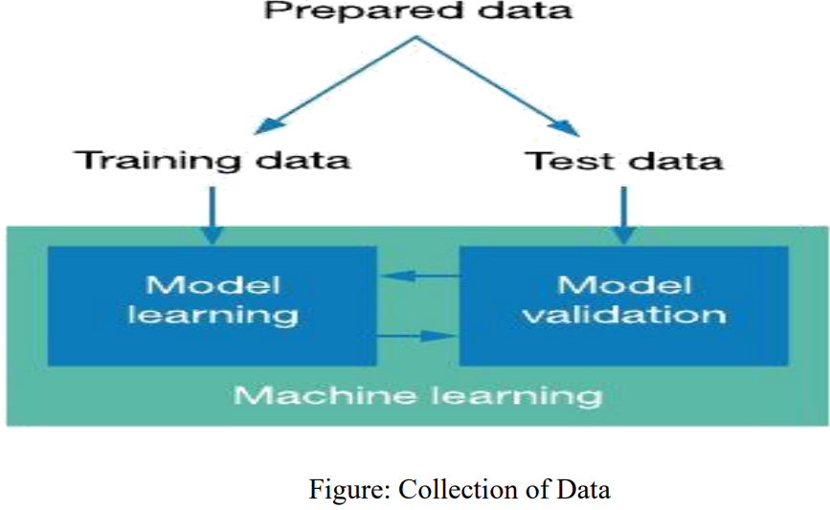
1 Collection of dataset:
Initially, we will be collecting a dataset for our heart disease prediction system model. After that the collection of the dataset, we are split the dataset into training data set and testing data set. The training data set is used for prediction model learning and testing data set is used for evaluating the prediction model. For this project, 70% of training data set is used and 30% of data set is used for testing. This The data set used for this project of Heart Disease UCI. This data set are consisting of 76 attributes; out of which, 14 attributes are used for the system.

Slide 12
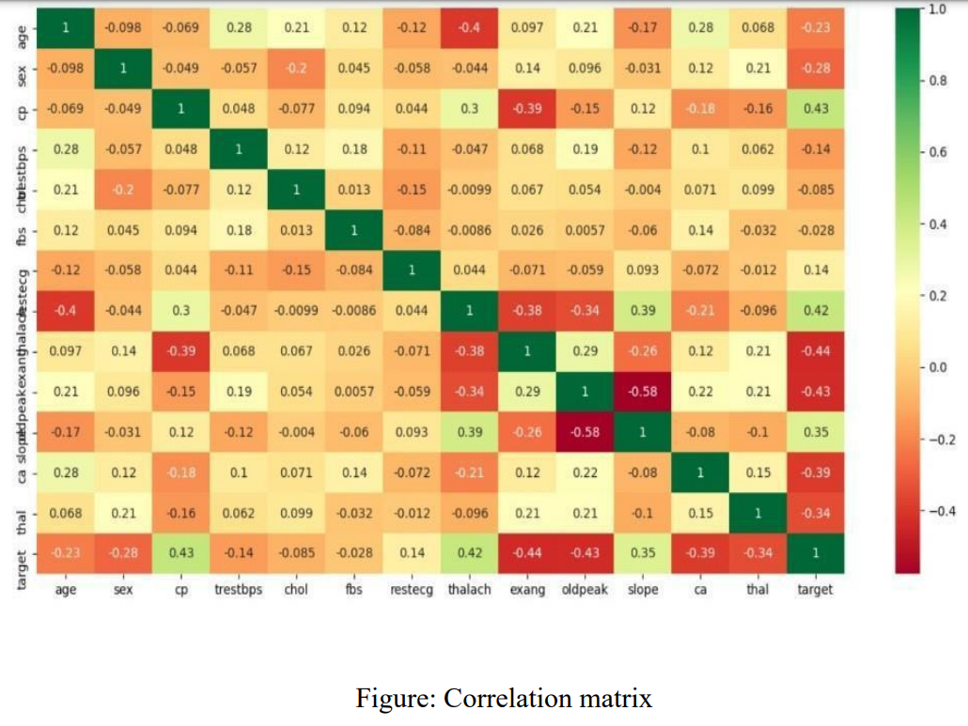
.2) Selection of attributes:
Attribute or Feature selections includes the selection of most appropriate attributes for the prediction systems. This is used to increase the efficiency of the system. The Various attributes of the patients. Like age, sex(gender), chest pain, fasting blood pressures, serum cholesterol ,Fbs, restecg,slope etc. are selected for the prediction system. The Correlation matrix are used for attribute selection for this model system.

Slide 13
SELECTION OF THE ATTRIBUTES DATASET:
S.NO. | Attribute | Description | Type
1 | Age | Patient’s age (29 to 77) | Numerical
2 | Sex | Gender of patient(male-0 female-1) | Nominal
3 | Cp | Chest pain type | Nominal
4 | Trestbps | Resting blood pressure( in mm Hg on admission to hospital ,values from 94 to 200) | Numerical
5 | Chol | Serum cholesterol in mg/dl, values from 126 to 564) | Numerical
6 | Fbs | Fasting blood sugar>120 mg/dl, true- 1 false-0) | Nominal
7 | Resting | Resting electrocardio graphics result (0 to 1) | Nominal
8 | Thali | Maximum heart rate achieved(71 to 202) | Numerical
9 | Exang | Exercise included agina(1-yes 0- no) | Nominal
10 | Oldpeak | ST depression introduced by exercise relative to rest (0 to .2) | Numerical
11 | Slope | The slop of the peak exercise ST segment (0 to 1) | Nominal
12 | Ca | Number of major vessels (0-3) | Numerical
13 | Thal | 3-normal | Nomin

Slide 14
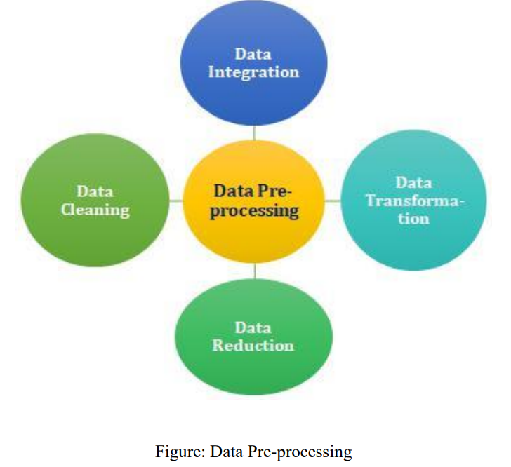
.3 )Pre-processing of Data:
Data pre-processing is all most important step for the creation of a machine learning algorithms model. Initially, The data may not be clean or in the required format for the model which can cause misleading outcomes data. In pre-processing of data, we transform the data into our required format model. And It is used to deal with noises, duplicates, and missing values of the dataset models. Data pre-processing has been the activities like importing datasets, And splitting datasets, attribute scaling, etc. Preprocessing of data set is required for improving the accuracy of the model System

Slide 15
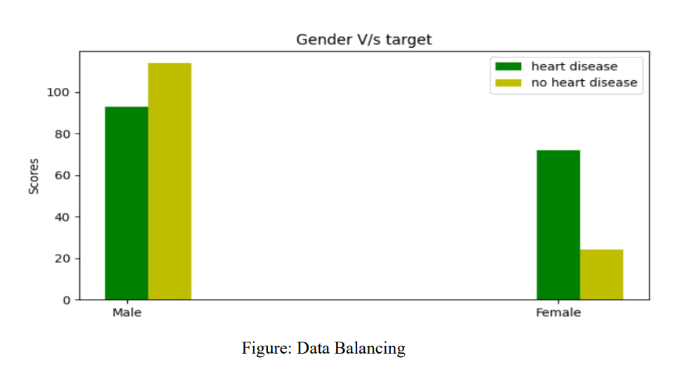
4) Balancing of Data:
Imbalanced datasets can be balanced in two ways methods. They are Under Sampling and Over Sampling
(a) Under Sampling: In Under Sampling, dataset balance is done by the reduction of the size of the ample class of data set and This process is considered when the amount of data is adequate.
(b) Over Sampling: In Over Sampling, dataset balance is done by increasing the size of the scarce samples class of data set .and This process is considered when the amount of data is inadequate.

Slide 16
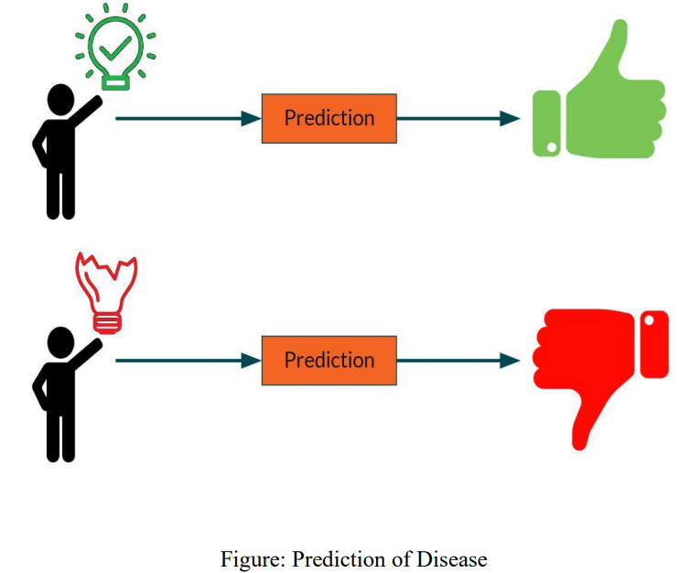
5) Prediction of Disease:
The too many Various machine learning algorithms like SVM, Naive Bayes, Decision Tree, Random Tree, Logistic Regression, Ada-boost, Xg-boost are used for classification. And Comparative analysis is performed among algorithms and the algorithm that gives the highest accuracy results is used for heart disease prediction systems.

Slide 17
APPLICATION:
It is utilizing the Data such as blood pressure, cholesterol, diabetes and then tries to predict the possible heart disease in patients' details (future Predication by diagnosis).
This may be help in talking to Preventive measure and hence can try to avoid the possibility of heart disease in patient.
So, When a patient is predicated as positive for heart disease, then the medical history data for the patient can be analyzed by the doctors

Slide 18
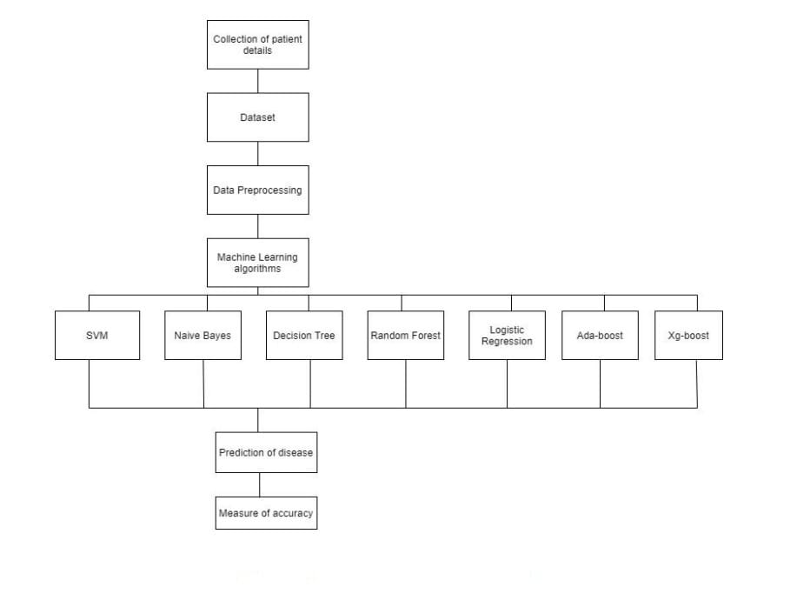
SYSTEM ARCHITECTURE:
This system architecture gives an overview of the working of the system.
This is the working of this system is described as follows:
Dataset collection is collecting the most important data which contains patient details. Attributes selection process selects the useful attributes for the prediction of heart disease systems. After that identifying the available of data resources, And they are further selected, And cleaned, made into the desired form also. Different classification techniques as stated will be applied on preprocessed data to predict the accuracy of heart disease systems. Accuracy measure compares the accuracy of different classifiers results.

Slide 19
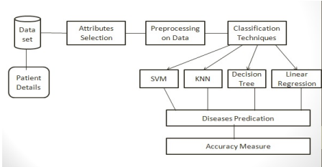
Architecture of Prediction System:

Slide 20

SYSTEM CONFIGURATION:
1 Hardware requirements:
• Processer : Any Update Processer
• Ram : Min 4GB
• Hard Disk : Min 100GB
2 Software requirements:
• Operating System : Windows family
• Technology : python 3.7
• IDE : Jupiter notebook

Slide 21
Machine Learning:
• Machine learning (ML) are the subset of artificial intelligences (AI). And It uses statistical techniques to enable computers to learn and make decisions without being explicitly programmed.
• ML are allowing machines to automatically to learn from data and past experiences to identify patterns and make predictions with minimal human intervention. For example, personal voice assistants like Siri, Alexa, and Cortana use to ML-based speech recognition systems.
• ML are also used in social media platform
• Types of machine Learning
• 1) Supervised Machine Learning.
• 2) Unsupervised Machine Learning.
• 3) Reinforcement machine Learning

Slide 22
1) Supervised MACHINE Learning :
Supervised machine learning is a type of the machine learning that are uses to labeled data to train algorithms and classify data or predict outcomes results. And In this supervised machine learning, the training data set has provided to the machines work as the supervisor that teaches the machines learning to predict the output results correctly. And It applies the same concept as a student learns in the supervision of the teacher. Supervised machine learning is a process of providing input data as well as correct output data to the machine learning model. The aim of a supervised machine learning algorithm is to find a mapping the function to map the input variable(x) with the output variable(y).

Slide 23
2)UNSUPERVISED MACHINE LEARNING:
• This Unsupervised machine learning is the type of machine learning technique method way that are uses to algorithms and find patterns in the unlabeled data set. Because Unsupervised machine learning could not be directly applied in a regression and classification problem because unlike supervised machine learning, we have the input data but not have the corresponding the output data. The goal of unsupervised machine learning is to find the underlying structure of dataset, and group that data according to similarities, and represent that dataset in a compressed format method.
• Unsupervised machine learning is helpful for finding to useful insights from the data.
• Unsupervised machine learning is much too like how a human learns and think by their own experiences, which makes it closer to the real AI.
• In The real-world basis, we don’t always have input data with the corresponding output results so to solve such as cases, so we need unsupervised machine learning.

Slide 24

3)REINFORCEMENT MACHINE LEARNING:
• Reinforcement machine learning is an area of Machine Learning. And It is regarding taking to a suitable actionand to maximize reward in a particular conditions . It is employed by various software and machines to find the best possible behavior or path it should be take in a specific situation.

Slide 25
MACHINE LEARNING ALGORITHMS:
• In this work, I have choice of Eleven machine leaning algorithms which are include
1) Random Forest
2) SVM
3) Decision Tree
4) Naïve Bayes
5) ANN
7) KNN
8) Logistic Regression
9) Linear Regression
10) Ada-boost
11) Xg-boost
These algorithms are used to unfold a prediction system which will be analyze to predict whether the patient is pertaining to any heart disease or not with best accuracy Results
6) DNN

Slide 26
1) Support Vector Machine:
• Support Vector Machine or SVM is one of the most important popular Supervised machine Learning algorithms, which are used for Classification as well as Regression problems. However, primarily, And it is used for Classification problems in Machine Learning.
• The main objective of the SVM algorithm is to find the optimal hyperplane in an N-dimensional space that can be a separate data points into different classes. The hyperplane tries to maximize the margin between the closest points of different classes point. The optimal divider is the one that is equidistant from the boundaries of each group class.
• SVMs were first introduced in the 1960s and refined in 1990. They are broadly classified into two types: simple or linear SVM and kernel or non-linear SVM .
• To train and test a SVM model data set , the data set are divided into train and test data. The data is also scaled to lie between 0 and 1

Slide 27
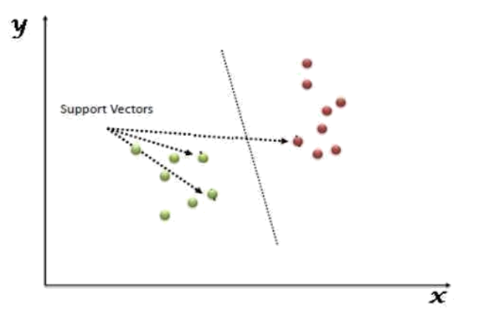
The followings are important concepts in SVM:
1) Support Vectors - Data Points that are very closest to the hyperplane are called support vectors. And Separating line will be defined with the help of these data points.
2) Hyperplane - As we can see in the above diagram, it is a decision plane or space which is divided between a set data of objects having different classes groups.
3) Margin - It may be defined as the gap between two lines on the closest data points of different classes group. It may be calculated as the perpendicular distance from the line to the support vectors. And Large margin is considered as a good margin and small margin is considered as a bad margin.

Slide 28
Advantages And Disadvantages of support vector machines:
ADVANTAGES:
● Effective in high dimensional spaces.
● Still effective in cases where the number of a dimensions is greater than the number of samples.
DISADVANTAGES:
● If the number of features is much greater than the number of samples and avoid the over-fitting in choosing Kernel functions and regularization term is crucial. SVMs do not be directly provide probability estimates and these are calculated using an expensive five-fold cross-validation methods.

Slide 29
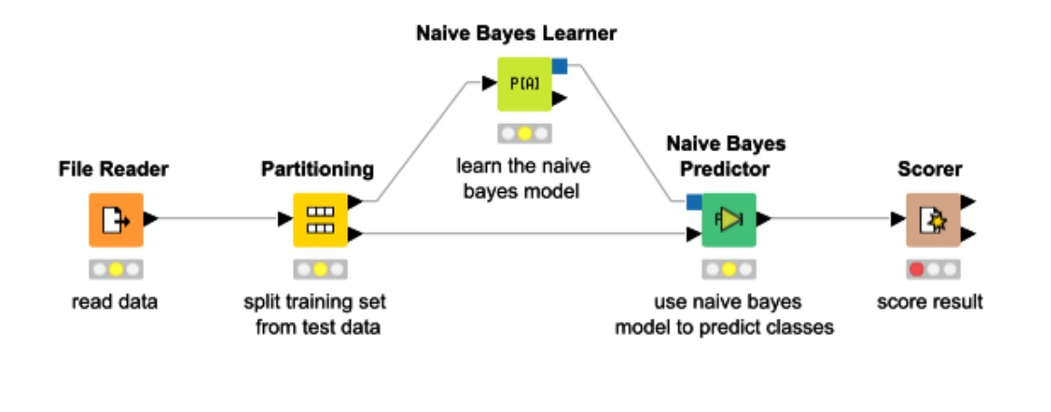
2) NAIVE BAYES ALGORITHM:
It is a machine learning technique that are works on this strategy of the Bayes’ Theorem. It is basically assuming that there would be no attributes And dependent on each other. And It is a group of algorithms that have a common principle that every feature is independent of the other group. Bayes’ Theorem tells us the probability of an event that will be occur when another event has already occurred. The mathematical equation is:
• Probability(a|z) = (Probability(z|a) * Probability(a)) / Probability(z)
• Where :
• Probability(a|z): Gives us the probability of a (the hypothesis) gives the data is a.
• Probability (z|a): Gives the probability of the data when the hypothesis is true.
• Probability (a): Regardless of the data, the hypothesis is said to be true.
• Probability (d): Regardless if the data, the probability of the hypothesis is given.

Slide 30
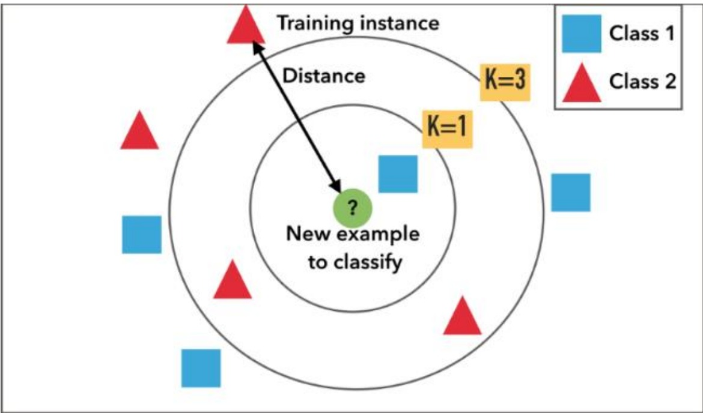
3) KNN:
• K nearest neighbors abbreviated as KNN is an algorithm that clusters data into classes and then classifies it as per their similarity measures. Classification is based on most of the votes to its neighbors. Data is assigned to the classes that have the nearest neighbors. As we increase the number of nearest neighbors, I.e., the value of k, the accuracy might be increase. KNN is broadly used for pattern recognition and statistical prediction methods.
• It divides the data into clusters And based upon the distance from the nearest neighbors.

Slide 31
4) Decision Tree :
• Decision Tree is one of the most supervised learning algorithms. In this the data is continuously split based on a certain parameter after which we end up getting the decision nodes and the leaves. What makes it different from the other supervised algorithms is that it can be also solve the regression and classification problems easily way. The main aim is to create a system that can be predict the results that we desire just by learning the decision rules from the prior data, i.e., the training set.

Slide 32
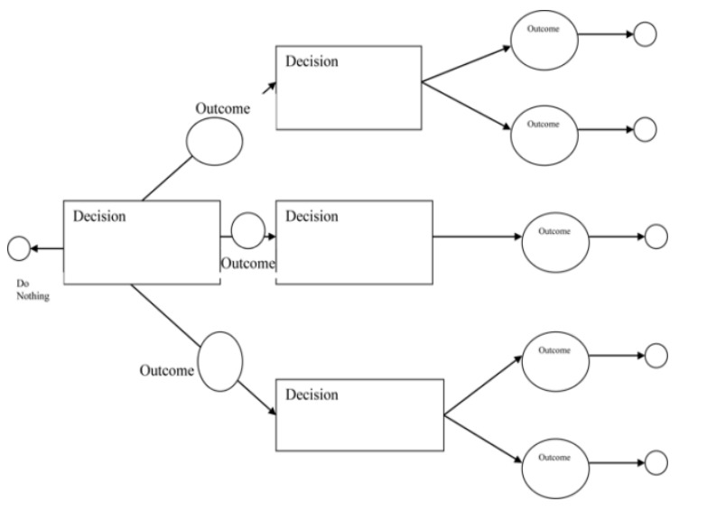
Working:
In a Decision Tree, for predicting the class of the given dataset, this is the algorithm starts from the root node of the tree. And This algorithm method way it can be compares the values of the root attribute set with the record (real dataset) attribute and based on the comparison, follows the branch and jumps to the next node. For the next node, the algorithm again compares the attribute dataset value with the other sub-nodes and moves further. It can be continuing the process until it reaches the leaf node of the tree. The complete process it can be better understood using the below algorithm steps:
● Step-1: Begin the tree with the root node, says S, which contains the complete dataset attributes.
● Step-2: Find the best attribute in the dataset using Attribute Selection Measure (ASM) dataset attributes.
● Step-3: Divide the S into the subsets that it can be contains possible values for the best attributes.
● Step-4: Generate the Decision Tree node, which can be contains the best attribute.
● Step-5: Recursively make new decision trees are using the subsets of the dataset attributes and created in step -3. method it is Continue this process until a stage and reached where you can not be further classifying the nodes and call the final node as a leaf node.

Slide 33
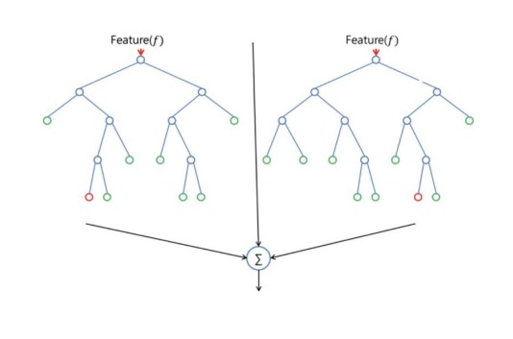
5) Random forest:
•This Random Forest algorithms , just as the name suggest creates several number of a random forest due to which it is also called the random decision forest. It is one of the most supervised learning algorithms. It is builds random forests that are basically just a group of decision trees. It is mostly trained with the bagging method as it is the most efficient. What are the bagging method does is, it combines all the learning models which can be turn in helps us with the overall result. Just like decision trees, it can be used for both, regression and classification problems.

Slide 34
Algorithm Steps:
It works in four steps method way:
● Select the random samples from a given dataset.
● Construct a Decision Tree for each sample and get a prediction result from each other Decision Tree.
● Perform a vote for each predicted result.
● Select the prediction result with the most votes as the final prediction system.

Slide 35
Advantages And Disadvantages:
ADVANTAGES:
● Random Forest can perform both Classification and Regression tasks.
● It is capable of handling larger datasets with high dimensionality.
● It enhances the accuracy results of the model and prevents the overfitting issue.
DISADVANTAGES:
Although Random Forest it can be used for both classification and regression tasks, it is not more suitable for Regression tasks.

Slide 36
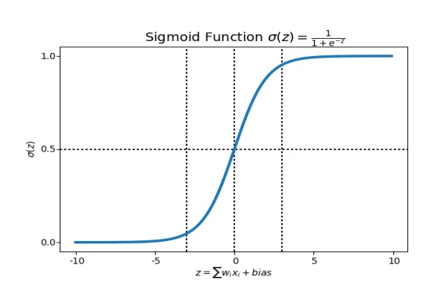
6) Logistic Regression:
• Logistic Regression algorithm is rather a predictive analysis. It is used to analyze the relation between the data among which one is a dependent variable, and the other one is independent variable. What doses logistic regression , it is rounds off all the values of the results to the closest binary value for the ease of prediction. This can be sometimes causing a few errors, and not predict very precisely. To remove this error, multiple regression is used which helps in getting the closest to the true result. Logistic Regression uses complex cost functions such as the ‘Sigmoid function’. In machine learning sigmoid is used to predict the probabilities.

Slide 37
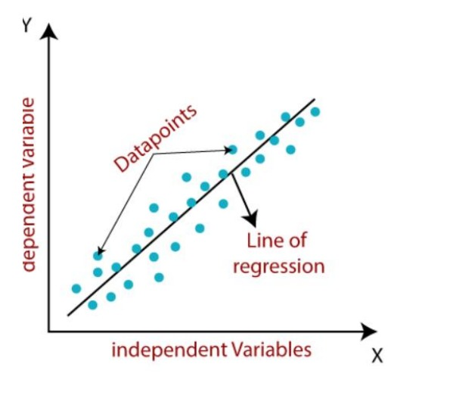
7) Linear Regression:
• Linear regression Algorithms is a fundamental machine learning algorithm it is used for predicting numerical values based on input features. It is assuming a linear relationship between the features and the target variable. The model learns the coefficients that best fit the data and can be make predictions for new inputs.
• in this Linear regression algorithm has shown a linear relationship between a two variables like dependent (y) and one or more independent (x) variables, hence called as linear regression. Since linear regression has shown the linear relationship, which means it is to finds how the value of the dependent variable is changing according to the value of the independent variables.
• The linear regression algorithms model has provided a sloped straight line and representing the relationship between the variables. Consider the below image:
y= Dependent Variable (Target Variable) y= Independent Variable (predictor Variable)

Slide 38
8) Artificial Neural Network (ANN):
An artificial neural network abbreviated as ANN is a model that works as the human brain or neural network I.e., the neurons. It is called a computational model that processes all the complex data. It isn’t given any task specific goal, but it learns from the examples or data that is given to it just like the brain. It is based on a collection of nodes called the artificial neuron. More the no. Of neurons, better the system. The neurons transmit signals from one to another making a proper connection which resembles the human neural network.
A neural network has the following 3 layers:

Slide 39
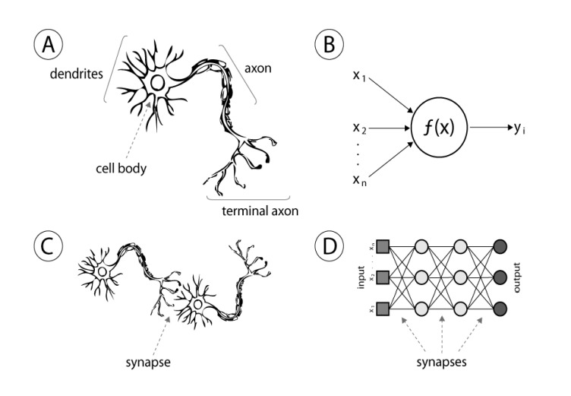
3 layers:
• Input layer – It is consisting of the complex raw info that we feed to the neurons.
• Hidden layer – These are the computational layers which has been taken the input and the weight of a node from the previous layers, processes it with the activation function will be and sends the output to the next layer.
• Output layer – This depends on the output of the hidden layers, and the functions taking place in there.
# The basic computational unit is the neuron. It is receiving inputs from the sources provided, and each input carries a weight, which has been given according to the relative importance of all the other inputs. Then the function is applied to

Slide 40
9) DEEP NEURAL NETWORK:
Deep Neural Network Algorithms abbreviated as a DNN, is a complex neural network consisting of more than 2 layers. This algorithm uses to high level of mathematical models for data processing in complex manner. Deep learning is derived from a vaster family of networks of neural methods, such as CNNs. Deep learning can either be unsupervised, supervised or semi- supervised.
Deep Convolutional and recurrent neural networks are utilized in natural language processing computer vision audio recognition video recognition, social network filtering bioinformatics machine translation image analysis, drug design, and material inspection where the outcomes were comparable/superior to some human professionals.

Slide 41
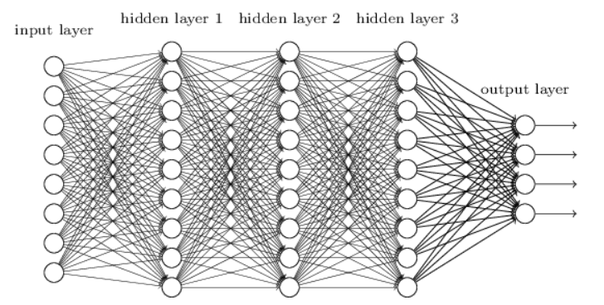
Deep Neural Networks:
• Use the different layers of nonlinear units of processing for featured extraction as well as transformation. Each of the successive layers uses the previous layer’s output as the input.
• Can be either too supervised and unsupervised or semi-supervised also.
• learn the different hierarchies of representations which relate to different hierarchies of abstractions.
• It is consisting of an input layer, an output layer and between many variable hidden layers.
• Output of one layer goes as the input to other. The activation function used in our module is the Re LU between hidden layers and SoftMax at the output layer which takes 0 or 1 .

Slide 42
10) ADABOOST ALGORITHM:
• Ada-boost was the first really successful boosting algorithm developed for the purpose of binary classification. Ada-boost is short for Adaptive Boosting and is a very popular boosting technique which combines multiple “weak classifiers” into a single “strong classifier”
• ALGORITHM:
• 1. Initially, Ada-boost is selecting and training subset randomly.
• 2. It is iteratively training the Ada-boost machine learning algorithms model by selecting the training data set and based on the accurate prediction of the last training.
• 3. It is assigning the higher weight to wrong classified observations so that in the next iteration these observations will get the high probability for classification.
• 4. Also, it is assigning the weight to the trained classifier in each iteration according to the accuracy of the classifier. The more accurate to classifier will get high weight.
• 5. This process will be iterating until the complete training data fits without any error or until reached to the specified maximum number of estimators.
• 6. To classify, perform a "vote" across all the learning algorithms you built.

Slide 43
Advantages And Disadvantages:
Advantages:
• It's easy to implement
• It can be used with any dataset
• It's less prone to overfitting than other algorithms
• It can improve the accuracy of weak classifiers
• It can be used with many base classifiers
• It's easier to use than other algorithms
• It can be used to classify text and images
• Disadvantages:
• AdaBoost uses a progressively learning boosting technique. Hence the high-quality of data is needed in examples of Ada-Boost vs Random Forest. And It is also very sensitive to outliers and noise in data requiring the elimination of these factors before using the data set model.

Slide 44
11) XGBOOST ALGORITHM:
• XG-Boost is a robust machine-learning algorithm that can be help you to understand your data and make better decisions. XG-Boost is an implementation of gradient-boosting decision trees.
• The Algorithms of XG-boost is an implementation of Gradient Boosted decision trees. It is an also type of Software library that was designed basically to improve speed and model performance. In this machine learning algorithm and decision trees are created in sequential form. Weights play an important role in XG-boost. Weights are assigned to all the independent variables which are then fed into the decision tree which is predicts results. The Weight of variables are predicted wrong by the tree is increased and these the variables are then fed to the second decision tree. These individual classifiers/predictors then assemble to give a strong and more precise model. It can work on regression, classification, ranking, and user-defined predict.

Slide 45
1) Regularization:
• Regularization: XG-Boost incorporates regularization techniques to prevent overfitting. It includes both L1 and L2 regularization terms in its objective function, which will be helps in controlling the complexity of the model and reducing variance.
• gamma: The minimum loss reduction allowed for a split to occur. The optimal value of a gamma is depending on the data set and other parameter values.
• alpha: L1 regularization on leaf weights. Larger values mean more regularization.
• lambda: L2 regularization. This term is a constant that is added to the second derivative function (Hessian) of the loss function during gain and weight (prediction) calculations.
• The regularization term (Ω) is a combination of L1 and L2 regularization terms. It is defined as:
• Ω(F) = λ * Ω1(F) + 0.5 * γ * Ω2(F)
• WHERE:
• Ω1(F) is the represent of L1 norm of the leaf weights
• Ω2(F) is the represent of L2 norm of the leaf weights
• Regularization parameters are usually to impact tree structure as well as weight values

Slide 46
2) Parallel processing:
• Parallelization – The process of sequential tree building is done using the parallelized implementation in the XG-Boost algorithm. This had made the possible due to the outer and inner loops that are interchangeable. The outer loop have listed the leaf nodes of a tree, while the inner loop will be calculating the features.
• : XG-boost will be utilizing the power of parallel processing and that is why it is much faster than GBM. It is uses multiple CPU cores to execute the model. While using Scikit Learn library, N thread hyper-parameter is used for parallel processing. N thread represents number of CPU cores to be used. If you want to use all the available cores, don't mention any value for N thread and the algorithm will detect automatically.

Slide 47
3) Handling missing values:
• XG-boost has an in-built the capability to handle missing values. When XG-boost encounters a missing value at a node, it is tries both the left and right hand split and learns the way leading to higher loss for each node. It then does the same when working on the testing dataset.
4) Cross Validation: The XG-boost will be allowing user to run a cross-validation at each iteration of the boosting process and thus it is easy to get the exact optimum number of boosting iterations in a single run. This is a unlike GBM where we must run a grid-search and only a limited values can be tested.

Slide 48
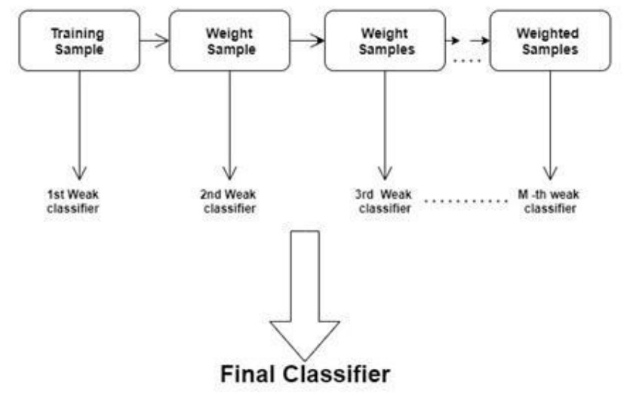
5) Effective Tree Pruning:
• Tree Pruning: The XG-Boost are uses to max-depth parameter as specified the stopping criteria for the splitting of the branch and starts pruning trees backward. This depth-first approach improves computational performance significantly.
• A GBM will be stop the splitting of a node when it encounters a negative loss in the split function. Thus, it is a more of a greedy algorithm. XG-boost on the other hand make splits up to the max-depth specified and then start pruning the tree backwards and remove splits beyond which there is no positive gain.

Slide 49
Predication of Disease:
• Predication of Disease is a Machine Learning based on a system which is primarily works according to the symptoms given by a user. And The disease has predicted to using an algorithms and comparison of the datasets model with the symptoms provided by the user.
• Machine learning (ML) can be predicting a diseases by using algorithms to compare a user's symptoms with datasets. The system takes the user's symptoms as input and outputs the probability of the disease.
• Some machine learning algorithms are used for disease prediction include:
• Naïve Bayes classifier: A supervised machine learning algorithm that calculates the probability of the disease
• Random forest classifier: Used to predict disease likelihood
• Support vector machine: A supervised learning algorithm
• Logistic regression: A supervised learning algorithm
• Artificial neural network: A supervised learning algorithm

Slide 50
DATA SET DETAILS :
For e.g.: Our system here, uses a dataset to predict the occurrence of heart diseases by dividing the dataset into test data and training data. 70% data set is used for training and the rest 30%data set are useing for testing. Now, the input used in our case is the attributes we have used that correspond to factors that result in heart diseases. The output would be a binary digit indicating whether a person is susceptible to heart diseases or not. The algorithms used in the system for prediction, are learning algorithms which will always change over periods of time based on various input factors . Therefore, the results might change when we learn even more about the data fed as input.
https://github.com/Abhayku18113211/Heart-Disease-Prediction-System-Using-ML

Slide 51
Data set used:
For our predicated system , we have taken dataset that was publicly available on online Kaggle for predicting the heart diseases. The parameters used as input for data analysis using of Machine learning algorithm are as follows:
1. age: which has taken in years
2. sex: 1 for male, 0 for female
3. cp: short for chest pain
4. Trest bps : blood pressure taken when the body is resting
5. Chol : level of cholesterol
6. fasting blood sugar: (1 for true; 0 for false)
7. resting electrocardiographic results Value 0: normal Value 1: having the ST-T wave which is not normal Value 2: shows the probability of having left ventricular hypertrophy
8. Thalach: the max level of heartbeats are achieved by heart
9. Exercise induced angina: 1 for yes and 0 for no
10. Oldpeak: the depression by exercise compared to the one at rest
11. slope: peak of the ST segment during exercise
Value 1: no slope
Value 2: straight line
Value 3: down sloping
12. ca: major vessels (0-3) colored by fluoroscopy
13. Thal: 3= perfect; 6=permanently defected; 7=defect can be altered 14. num: heart disease diagnoses.

Slide 52
Measure of Accuracy (Performance Analysis):
• In this project review various machine learning algorithms like SVM, Naive Bayes, Decision Tree, Random Forest, Logistic Regression, Ada-boost Xg-boost are used to predict heart disease. Heart Disease Predication UCI dataset, has been a total of 76 attributes, out of those only 14 attributes dataset are considered for the prediction of heart disease. Various So many attributes dataset of the patient like sex , chest pain type, fasting blood pressure, serum cholesterol,Slope,fbs Exang etc. are considered for this project. The accuracy for individual algorithms must be measure and which ever algorithm is giving the best accuracy results that is considered for the heart disease prediction. For evaluating the experiment, various evaluation metrics like accuracy, confusion matrix, precision, recall, and f1-score are considered.
Accuracy- Accuracy is the ratio of the number of correct predictions to the total number of inputs in the dataset.
• 1) The accuracy rate of each algorithm has been measured and selects the algorithm with the highest accuracy Results. The accuracy rate is a correct prediction ratio to the total number of given datasets. It is expressed as:
• Accuracy = (TP + TN) /(TP+FP+FN+TN)
• Where:
• TP: True Positive
• TN: True Negative
• FP: False Positive
• FN: False Negative

Slide 53
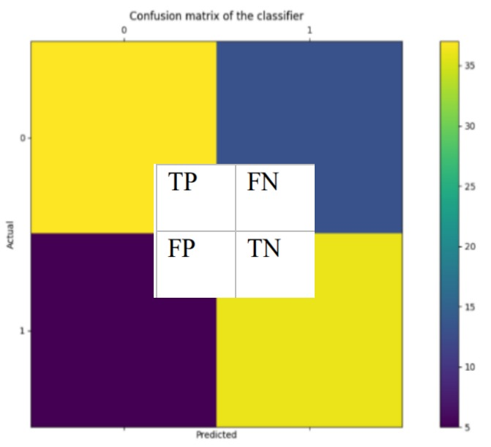
1)Confusion Matrix:
• It is gives us a matrix as output and gives the total performance of the S system.
• It is a binary classifier. A confusion matrix that can be of any size depending upon the different number of parameters inputted (labels in our case).
• Where:
• TP: True positive
• FP: False Positive
• FN: False Negative
• TN: True Negative
• The Mathematically numerical value of TP, FP, TN, FN defines as:
• TP= The occur when the model accurately predicts a positive data point.
• TN= The occur when the model accurately predicts a negative data point.
FP= The occur when the model predicts a positive dataset point incorrectly.
FN= The occur when the model mis predicts a negative data point.

Slide 54
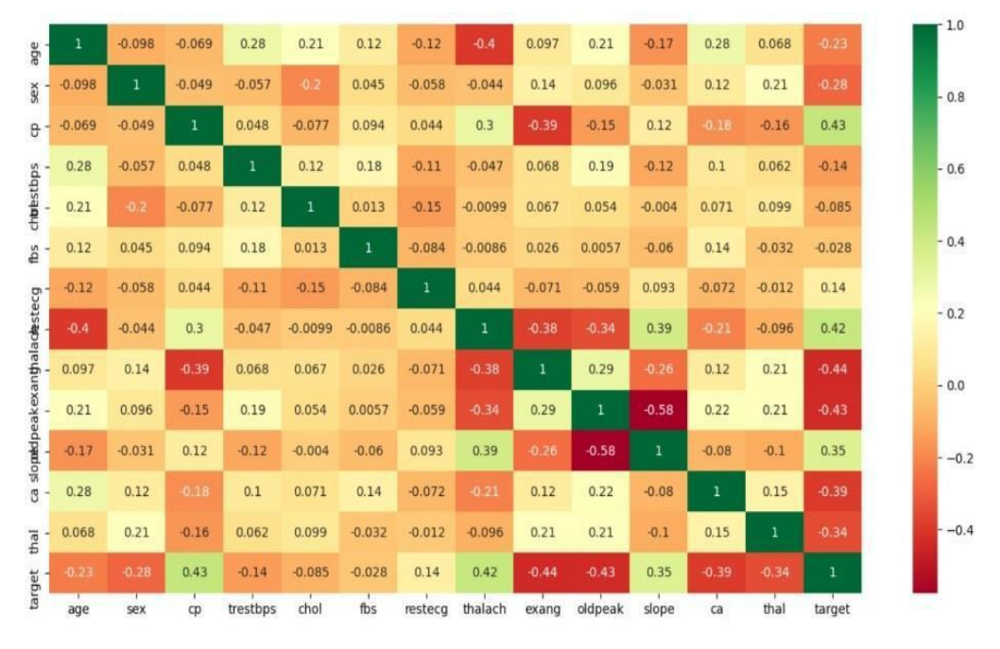
2) Correlation Matrix:
The correlation matrix in machine learning Algorithm that is used for feature selection. And It is representing dependency between various attributes dataset. Selection of attributes dataset: The Dataset of Attribute or Feature selection includes the selection of appropriate attributes for the prediction system. This is used to increase the efficiency of the system. The Various attributes of the patients like sex,age, chest pain type, fasting blood pressure, serum cholesterol, fbs,slope,exang etc. are selected for the prediction. The Correlation matrix are used for attribute selection for this model System.

Slide 55
3) Precision:
• It is the ratio of correct positive results to the total number of positive results are predicted by the Predication system.
• 𝑃𝑟𝑒𝑐𝑖𝑠𝑖𝑜𝑛 = 𝑇𝑃/(𝑇𝑃 + 𝐹𝑃)
• It is expressed as:
• 4) Recall-
It is using the ratio of correct positive results to the total number of positive results are predicted by the Predication system.
• 𝑅𝑒𝑐𝑎𝑙𝑙 = 𝑇𝑃/(𝑇𝑃 + 𝐹𝑁)
• 5) F1 score-:
This metric is taken into a recall and precision model and is calculated as below
It has been in the Precision of a and Recall. It is measuring the test accuracy of Results. And The range of this metrics between 0 to 1.
𝐹1 𝑠𝑐𝑜𝑟𝑒 = 2 ∗ (𝑃𝑟𝑒𝑐𝑖𝑠𝑖𝑜𝑛 ∗ 𝑅𝑒𝑐𝑎𝑙𝑙)/(𝑃𝑟𝑒𝑐𝑖𝑠𝑖𝑜𝑛- + 𝑅𝑒𝑐𝑎𝑙𝑙)

Slide 56
Example Of Confusion Matrix For Measure Accuracy (Performance Analysis):
A 2X2 Confusion matrix is shown below for the image recognition having a Heart Patient image or Not Heart Patient image.
INDEX | 1 | 2 | 3 | 4 | 5 | 6 | 7 | 8 | 9 | 10
Actual | Patient | Patient | Patient | Not Patient | Patient | Not Patient | Patient | Patient | Not Patient | Not Patient
Predicted | Patient | Not Patient | Patient | Not Patient | Patient | Patient | Patient | Patient | Not Patient | Not Patient
Result | TP | FN | TP | TN | TP | FP | TP | TP | TN | TN
Actual Patient Counts = 6
Actual Not Patient Counts = 4
True Positive Counts = 5
False Positive Counts = 1
True Negative Counts = 3
False Negative Counts = 1

Slide 57
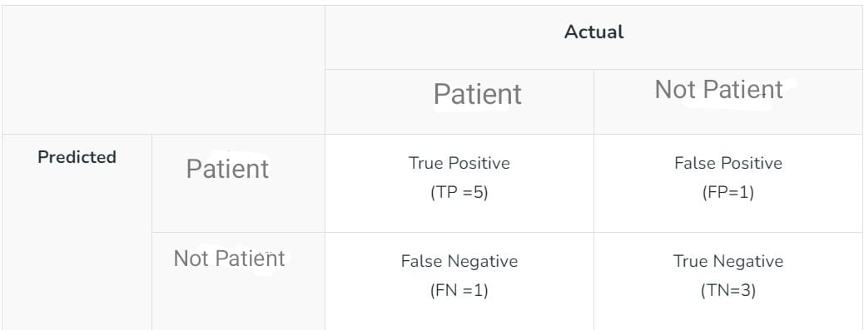
Metrics based on Confusion Matrix Data:
2. Precision
2) Precision : it is the method way of a measure of how an accurate a model’s positive predictions are. It has been defined as the ratio of true positive predictions to the total number of positive predictions made by the model.
𝑇𝑃/(𝑇𝑃 + 𝐹𝑃)
For the above case: Precision = 5/(5+1) =5/6 = 0.8333
1. Accuracy
Accuracy is used to measure the performance of the model. It is the ratio of a Total correct instances to the total instance's methods.
Accuracy = (TP + TN) /(TP+FP+FN+TN)
For the above case:
Accuracy = (5+3)/(5+3+1+1) = 8/10 = 0.8

Slide 58
3. Recall
It is using the ratio of correct positive results to the total number of positive results are predicted by the Predication system.
• 𝑅𝑒𝑐𝑎𝑙𝑙 = 𝑇𝑃/(𝑇𝑃 + 𝐹𝑁)
For the above case:
Recall = 5/(5+1) =5/6 = 0.8333
4. F1-Score :
F1 – Score: this matric is taken into a recall and precision model and is calculated as below:
It has been in the precision of a and recall.it is measuring the test accuracy of Results. And The range of this metrics between 0 to 1.
𝐹1 𝑠𝑐𝑜𝑟𝑒 = 2 ∗ (𝑃𝑟𝑒𝑐𝑖𝑠𝑖𝑜𝑛 ∗ 𝑅𝑒𝑐𝑎𝑙𝑙)/(𝑃𝑟𝑒𝑐𝑖𝑠𝑖𝑜𝑛 + 𝑅𝑒𝑐𝑎𝑙𝑙)
For the above case:
F1-Score: = (2* 0.8333* 0.8333)/( 0.8333+ 0.8333) = 0.8333

Slide 59
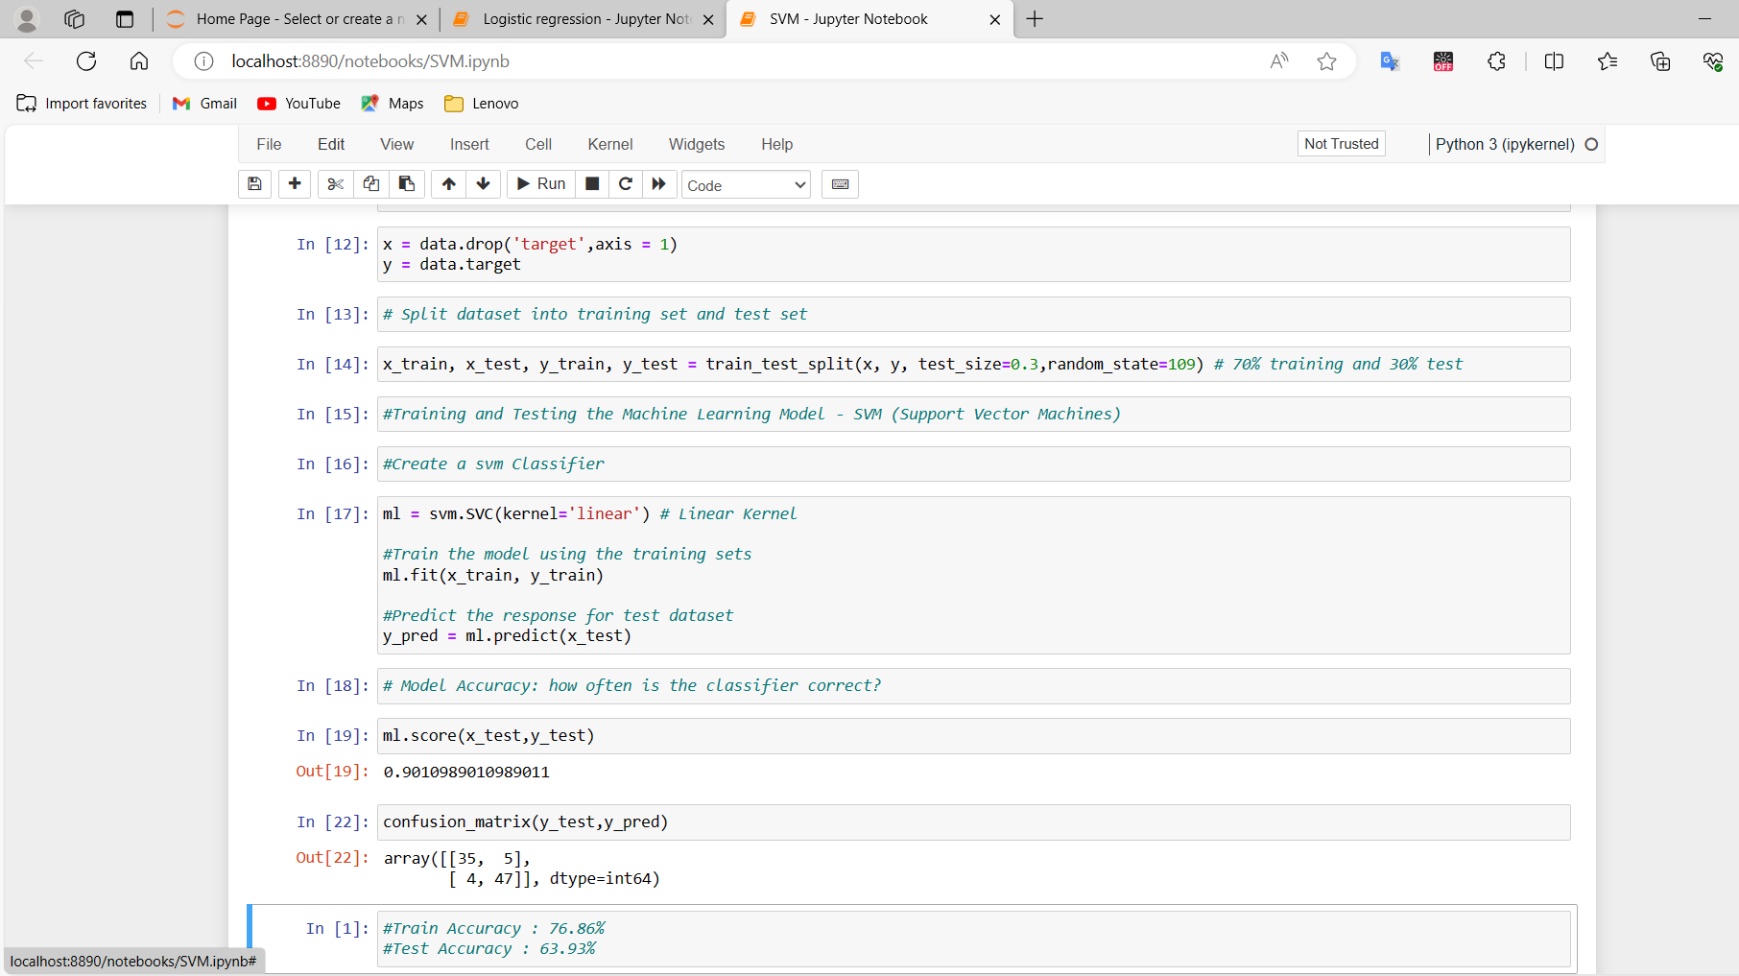
PERFORMANCE OF MACHINE LEARNING ALGORITHMS :SVM
Accuracy : 0.901
Precision : 0.904
Recall : 0.922
Fi Score : 0.909
 |  | Actual Value | Actual Value
 |  | Positive | Negative
Predicated Value |  | TP: 47 | TN:35
Predicated Value |  | FP:5 | FN:4

Slide 60
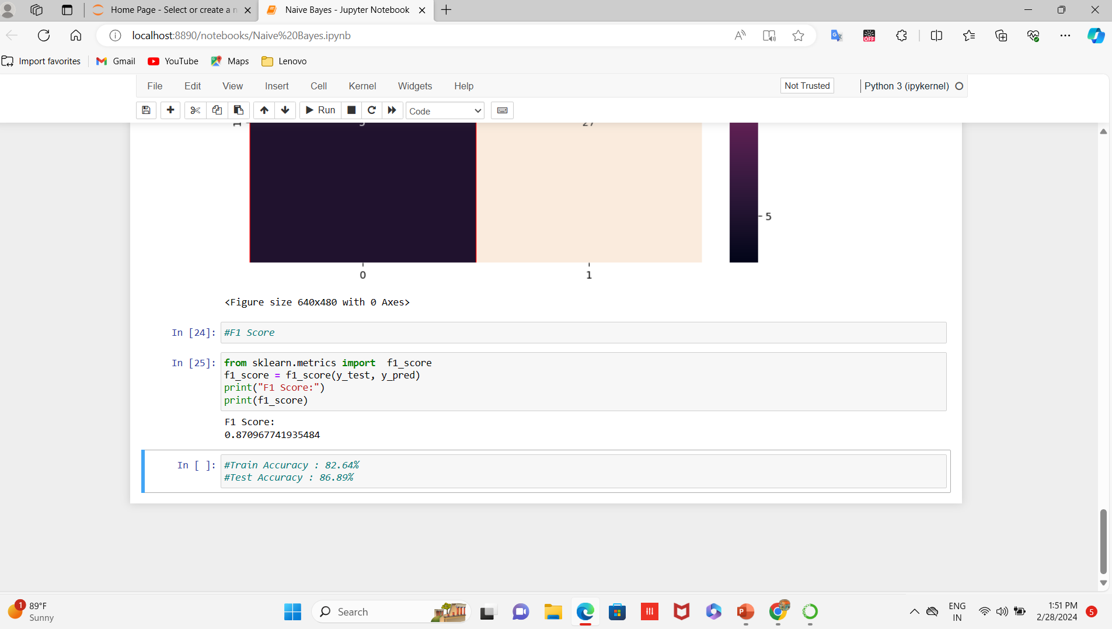
Naïve Bayes Results:
Accuracy : 0.869
Precision: 0.900
Recall : 0.844
F1 Score : 0.871
 |  | Actual Value | Actual Value
 |  | Positive | Negative
Predicated Values | True | TP: 27 | FN: 26
Predicated Values | False | FP: 3 | TN: 5

Slide 61
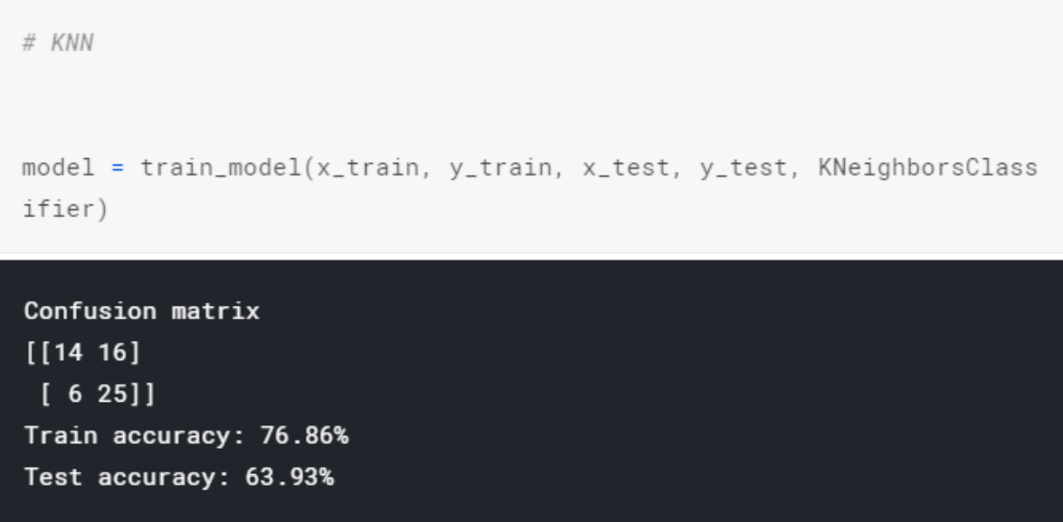
KNN RESULTS:
Accuracy : 0.639
Precision : 0.4666
Recall : 0.76
F1 Score :
 |  | Actual Value | Actual Value
 |  | Positive | Negative
Predicated Value | True | TP:14 | FN:16
Predicated Value | False | FP:6 | TN:25

Slide 62
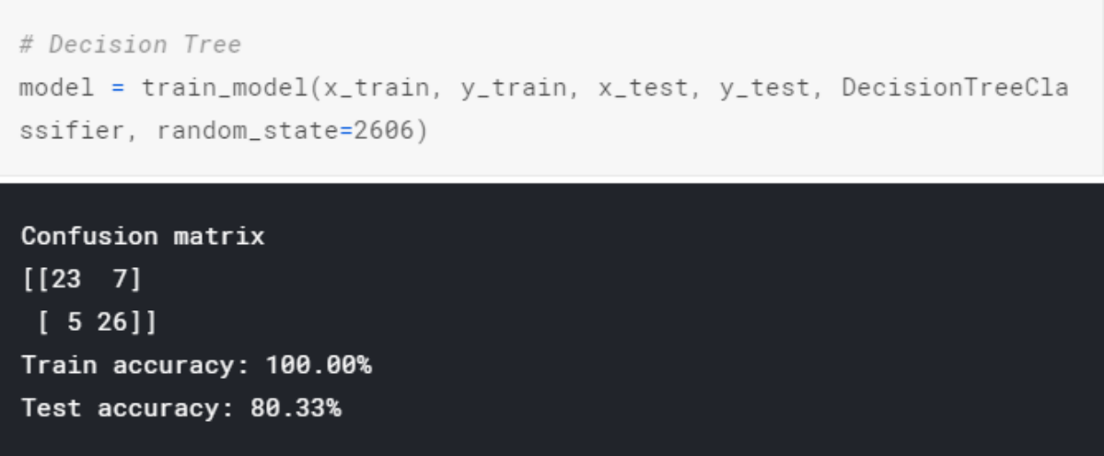
DECISION TREE RESULTS:
ACCURACY: 0.8033
RECALL: 0.7666
PRECISION: 0.821
F1 Score : 0.271
 |  | Actual Value | Actual Value
 |  | Positive | Negative
Predicated Values | True | TP: 23 | TN: 7
Predicated Values | False | FP: 5 | FN: 26

Slide 63
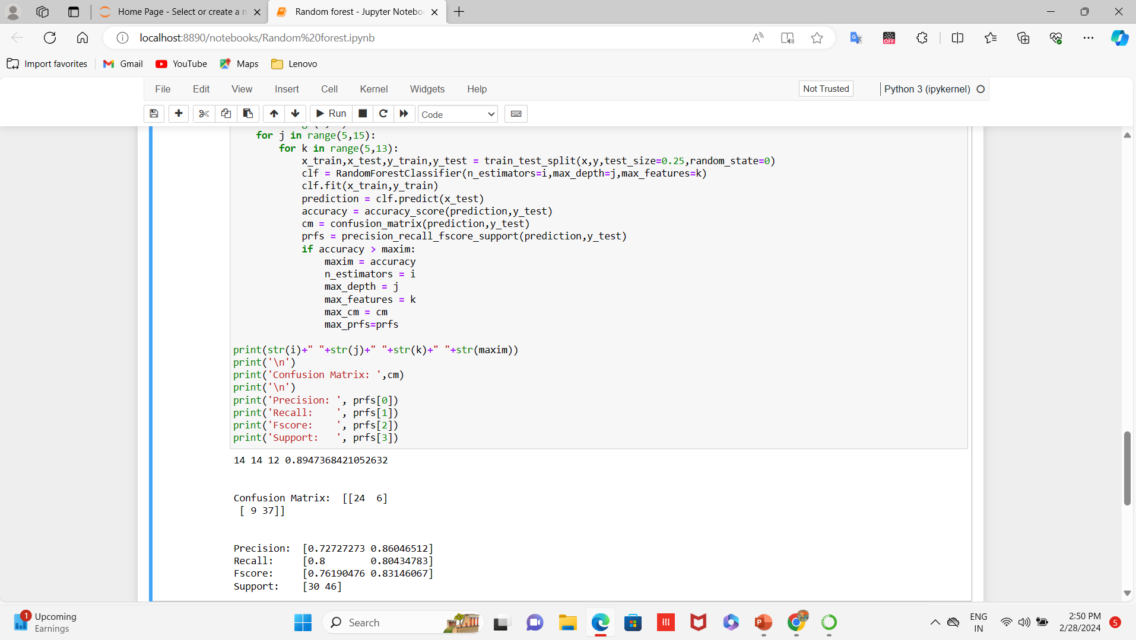
RANDOM FOREST RESULTS:
ACCURACY: 0.803
RECALL:0.8 04 F1Score 0.832
PRECISION:0.860
 |  | Actual Value | Actual Value
 |  | Positive | Negative
Predicated Values | True | TP:24 | TN:6
Predicated Values | False | FP:9 | FN:37

Slide 64
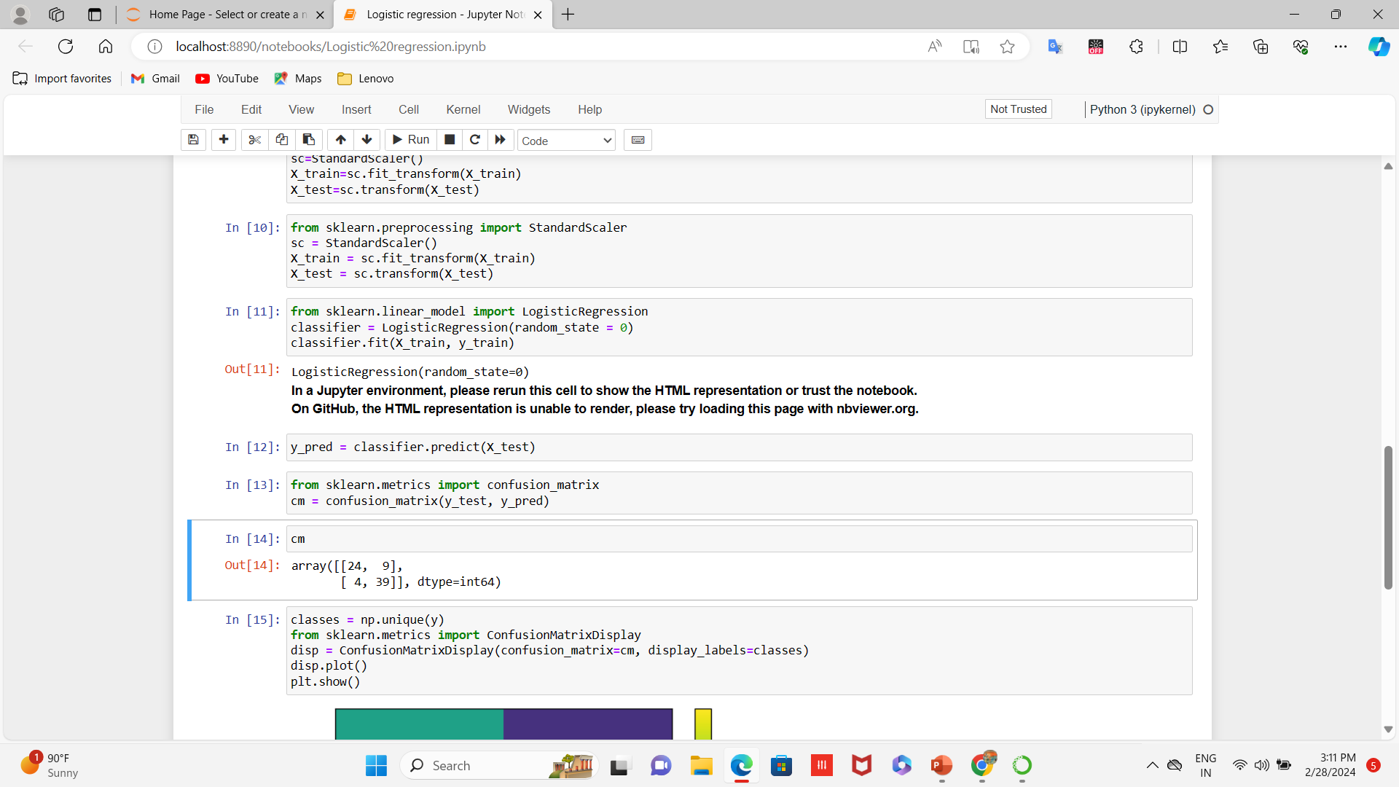
LOGISTIC REGRESSION RESULTS:
ACCURACY: 0.829
RECALL:0.907
PRECISION:0.813
F1 Score: 0.856
 |  | Actual Value | Actual Value
 |  | Positive | Negative
Predicated Value | TRUE | TP:24 | TN:9
Predicated Value | FALSE | FP:4 | FN:39

Slide 65
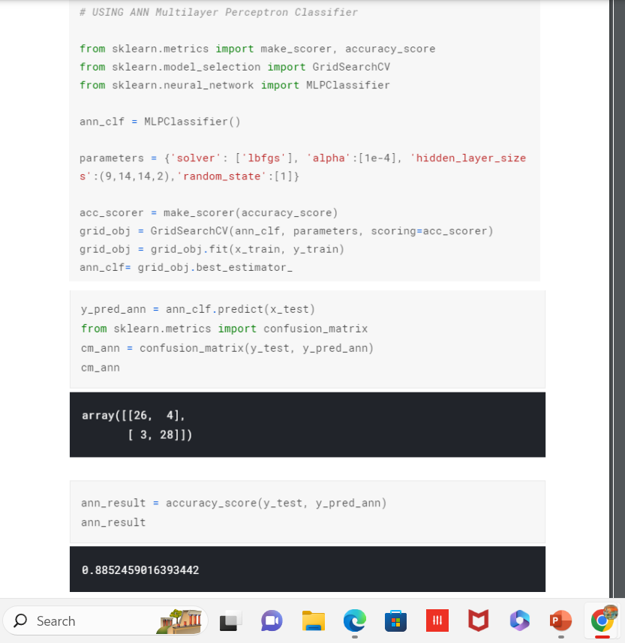
ANN RESULTS:
ACCURACY: 0.8852
RECALL: 0.8666
PRECISION:0.8965
F1 Score:0.84699
 |  | Actual Value | Actual Value
 |  | Positive | Negative
Predicated Values | True | TP:26 | TN:4
Predicated Values | False | FP:3 | FN:28

Slide 66
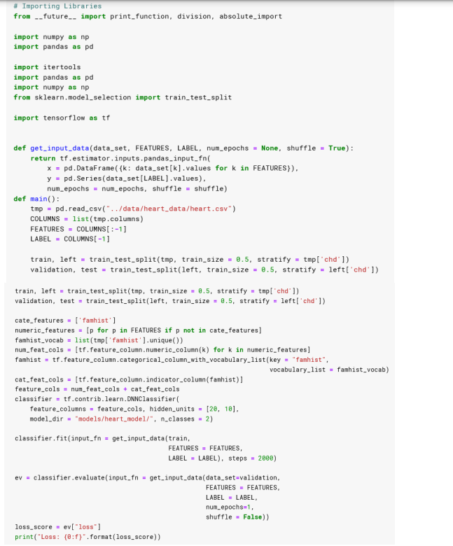
DNN RESULTS:
ACCURACY: 0.918
RECALL: 0.9033
PRECISION: 0.9655
F1 Score:0.5320
 |  | Actual Value | Actual Value
 |  | Positive | Negative
Predicated Values | True | TP:28 | FN:3
Predicated Values | False | FP:1 | TN:28

Slide 67
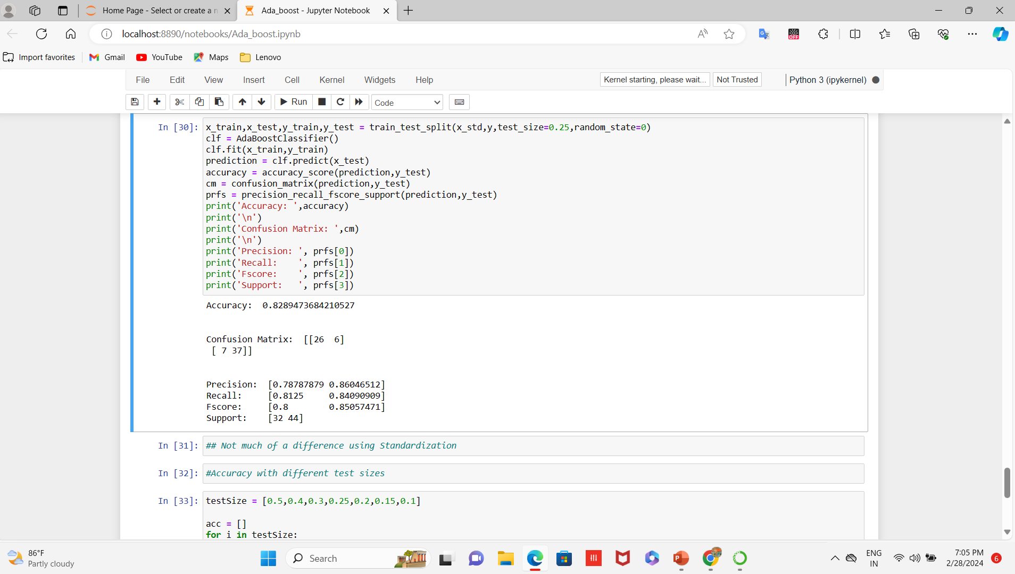
ADA-BOOST RESULTS:
Accuracy:0.829
Precision:0.860
Recall:0.841
F1 Score:0.849
 |  | Actual Value | Actual Value
 |  | Positive | Negative
Predicated Values | True | TP:26 | FN:6
Predicated Values | False | FP:7 | TN:37

Slide 68
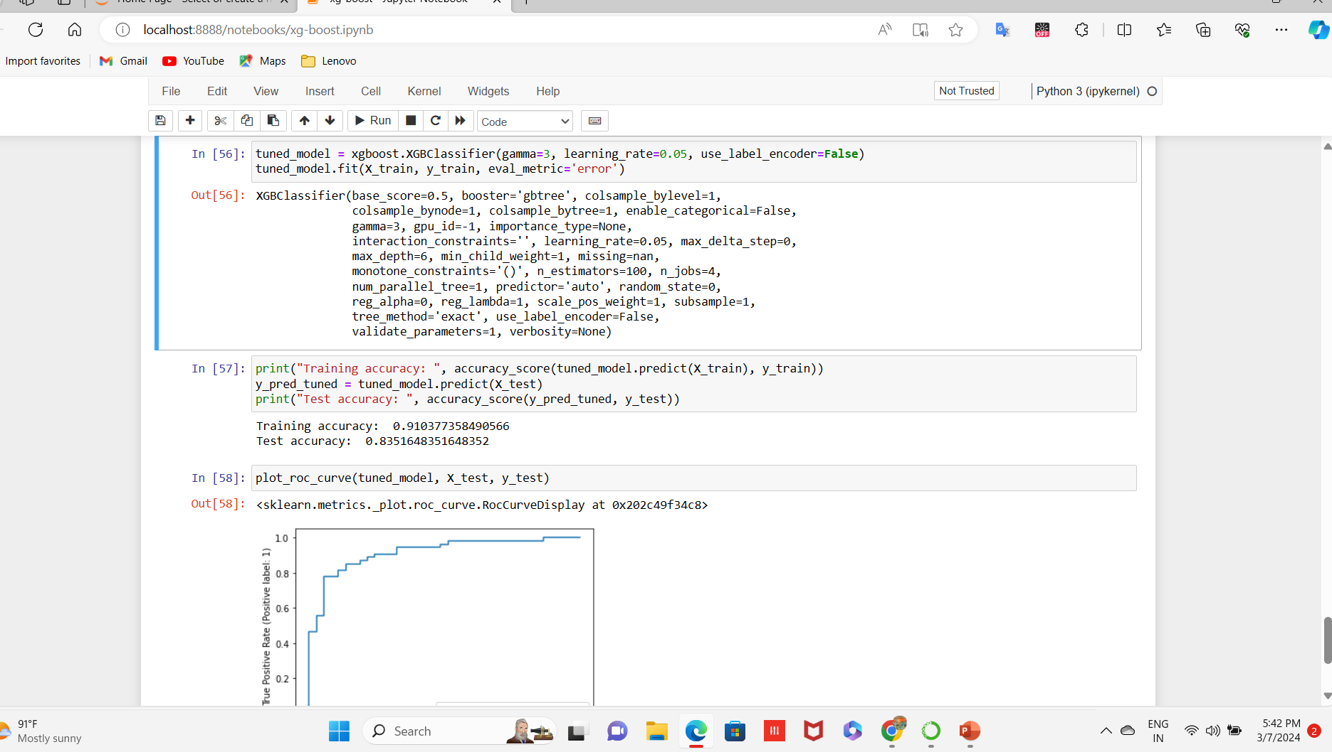
XG-BOOST RESULTS:
Accuracy: 0.918
Precision:0.960
Recall:0.857
F1 Score:0.905
 |  | Actual Value | Actual Value
 |  | Positive | Negative
Predicated Values | True | TP:32 | FN:1
Predicated Values | False | FP:4 | TN:24

Slide 69
COADING AND TESTING:
1) Software Requirement:
1. Anaconda : It is an open-source software available to us which has been enables us to easily code in using python or R on different operating systems such as the windows, Linux, and Mac OS. It has been millions of users worldwide and is well known as the industry which helps us in developing the systems, testing them, and training the machines. This is further enables us to:
• Manage all the imported libraries, And their dependencies, and the environments of developing with Anaconda.
• In developing techniques method to train our machine with TensorFlow, And scikit-learn, etc.
• it is Analyze the datasets and manipulate the with Dask, NumPy, pandas, and Numb
• The Visualize or plot the results with Matplotlib, Holoviews, Bokeh, and Data shader. It is also providing us with jupyter notebooks which has all the in-built libraries embedded in the already. This eases our coding stress, and also helps us code with more efficiency results.
2. Python: The most abundantly used general high level programming language. It is used for both a small scale and big scale systems. It can be easily be interpreted. And It is said to support multiple programming paradigms. It is including features of procedural, object-oriented, and functional programming together. It is already garbage-collected which makes it more efficient.
3. Numpy: It is a python programming library. This is basically helps us to deal with large datasets, matrices, and multi-dimensional arrays. It is also providing us with several mathematical functions which help us and ease the calculations. It is an open-source software available to all.
4. Pandas- It is a library that is written in python Programming language. It is helps us with the analyzing of data. It is also providing us with tools and functions to manipulate a large amount of dataset.
5. Sklearn : It is a library used in machine learning Algorithms in python programming language. It is mainly helps us with the classification of data,And regression of models, and in clustering algorithms. These algorithms include SVM, random forest etc.
6. Tensorflow- It is a highly know as open-source software, which is free and available to all. It is used for differentiable programming with a large number of tasks dataset. It is used against large data sets to help us with the dataflow, and its manipulation. It is a basically a math library with various features.

Slide 70
2 )OBJECTIVES AND TYPES OF TESTING:
Testing is the performed so that we can be locate problems. It is the method of identifying all the possible faults of any system. Also, it is acts as method to test the functionality of all the individual components and the system. It is the process of verifying that the hardware system And performs its functionalities and meets user needs and expectations. Testing ensures that even if the product fails, it is fails in a controlled condition that can be managed later. There are various types of test. Each of the test is used to address a particular testing needs.
2.1 UNIT TESTING This testing means it is including the creation of test scenarios that verify that program is working in the way it can be supposed to. In this type of testing, the objective is to validate that each module or unit is performing the tasks that it is supposed to do. A unit is the smallest part that must be tested.
2.2 INTEGRATION TESTING These tests are made just to check the different parts after that they have been integrated to determine whether they are functioning properly as a unit or not. This type of testing is driven by events and is more curious about the outcomes of the component. Integration tests show that although the components are working properly as individual but also the combination of components is also working properly.
2.3 FUNCTIONAL TESTING These kind of tests are providing systematic demonstration of the functions tested and the proof of their functioning being successful. Functional testing is targeted at a valid input, invalid input, functions, output, procedures. And The preparation on functional tests is focused on the requirements, key functionalities, different and extreme test cases
2.4 SYSTEM TESTING This is type of tests tells us whether the whole system after all its parts has been joined together meets the need of shareholders. It is checks and confirms the known and expected results. These kinds of testing are done to check whether the system delivers what it was supposed to. It can be checks whether the all the parts work well with each other or not.
2.5 WHITE BOX TESTING It is done in a way such that the tester has been information about all the components, workings, structure and architecture of the hardware/software. It is used for deep level testing to ensure that those places that are not accessible by a black box test are covered in white box testing. It basically means that there shall be no blind spots in the system.
2.6 BLACK BOX TESTING Here the testing that is done on the software/hardware by someone who has been no information on how to operate it. Before a product is developed some documentation is done, they include requirement analysis documents that has all the details about what a product must be. Now these tests are based on those sources only. Imagine a black colored box, you can be not seeing into it. You know nothing about what it contains. This is exactly how the testing is done.

Slide 71
3) TESTING IN MACHINE LEARNING:
Very easily put, in machine learning Algorithms is a type of system/application which is based upon models that are use prediction and analysis. Building these systems is a hard task, but testing and validating the entire system is even more difficult. And The Traditional methods of testing are always based on stationary inputs. And The output will also be fixed as the input remains fixed, but in the case of machine learning, the system has been built along with the input, which will be change or modify as we come to know more and more about it, therefore unlike the traditional system, the output here will be never remain fixed. Hence, the strategies for testing a machine learning system must be a bit different. Below are some of these strategies mentioned that can be used in testing the machine learning systems.
1. Development of training datasets: Here, a subset of dataset that is used for training purpose, which means it can be used to train the system to obtain the given prediction. It is supervised, i.e., the output is given along with the input.
2. Development of testing data sets: The testing data set is a training data subset that has been built in an intelligent way to check the how robustly our system has been trained and to check all the combinations that are possible. The resultant model will be finely tuned according to the outputs of the testing dataset.
3. Development of validation and correction test suite: This is based on algorithms and test datasets. For e.g., in our Project system scenarios consist of clustering results based upon the different factors/attributes and creating profiles of risk depending upon behaviors and demography.
4. Understanding the algorithm: All of this is dependent upon calculations and how the different algorithms use different calculations. Some algorithms like regression-based algorithms give some numeric results regressively, or continuously. On the other hand, And there are some algorithms that are calculate the results by dividing the outcomes into different parts or behaviors, and then some algorithms are create to multiple layers between the input and output layer. Continuous mathematically numeric variables such as return on investment.
5. Using Statistics for conveying the results : The Outcomes are generally predicted in the form of working model, or a numeric value or a working interface or something like that. But in machine learning algorithms, the use of bars, histograms and other statistical diagrams it is used to depict the prediction or analysis in a more comparative or mathematical method way. (The machine learning models will usually have approximate, and not actual results upon validation. In conclusion, software testing is as crucial and important a task in machine learning, as is in any other traditional system, but unlike those systems , our testing is based on more dynamic factors and generally will produce a relative or approximate result which can be best shown statistically).

Slide 72
4) TEST CASES:
SR NO. | TEST CASE NAME | TEST CASE DESCRIPTION | EXAMPLE TEST CASE | EXPECTED OUTPUT
1 | Equivalence Partitioning | This divides the input dataset of a software unit into a partitions of equivalent data from which can be test cases can be derived. | The dataset can be divided into two classes based on the number mapped with state. The valid partitions are : Mapped State Valid Invalid 0,1 Any no. other than 0,1. | If valid: Successful. invalid: Unsuccessful.
2 | Boundary Value Analysis | In this we focus on the boundary values of the various valid and invalid inputs data. | We want to test the value of the age to be a positive integer values. | If valid: Successful. invalid: Unsuccessful
3 | Data input | To check what happens when the data is inputted in the wrong format. | Instead of giving the input in 0’s and 1’s. The data is fed into the system as alphabets. For example, Sex of the person. | The code must be throwing an error pertaining to change of format of the data inputted.

Slide 73

SIMPLE CODE:
https://github.com/Abhayku18113211/Heart-Disease-Prediction-System-Using-ML

Slide 74
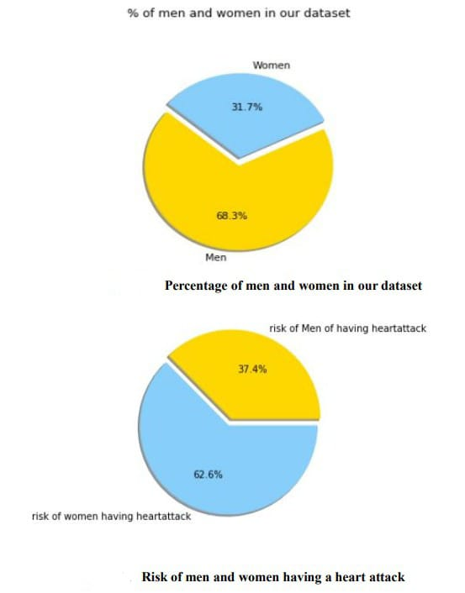
RESULTS FROM THE TEST DATA SET:
We have done extrapolation of data set in regards to heart disease on basis of various factors which are Sex, Age, Blood pressure, Serum cholesterol and so.

Slide 75
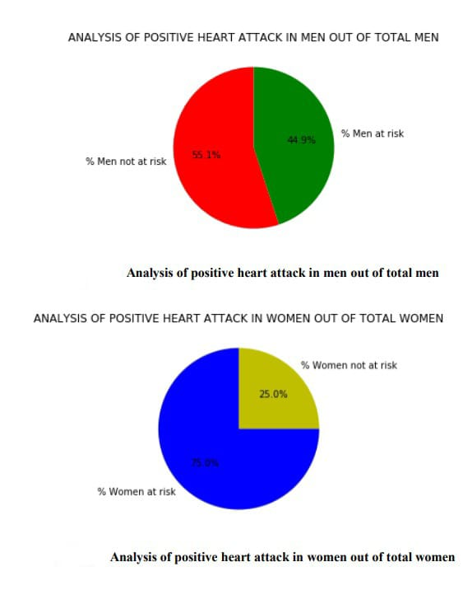
ANALYSIS OF POSITIVE HEART ATTACK IN MEN OUT OF TOTAL MEN AND WOMEN OUT OF TOTAL WOMEN:

Slide 76
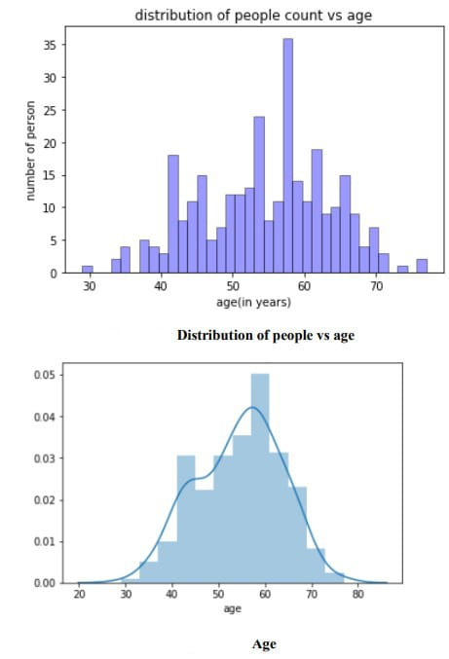
Distribution of people vs age:

Slide 77
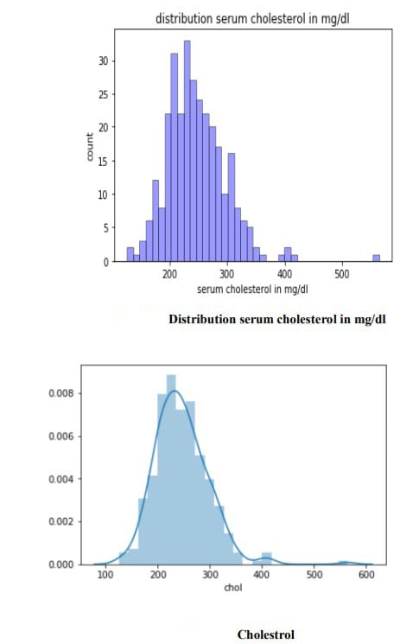
Distribution serum cholesterol in mg/dl:

Slide 78
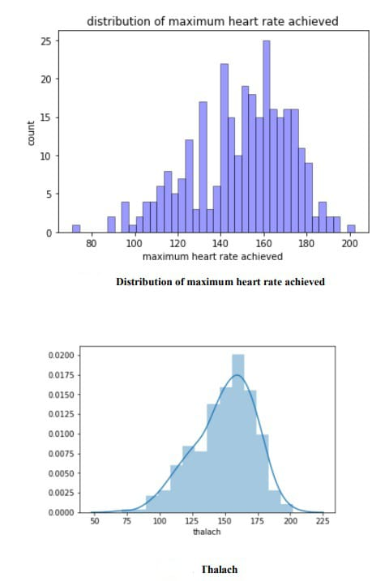
Distribution of maximum heart rate achieved:

Slide 79
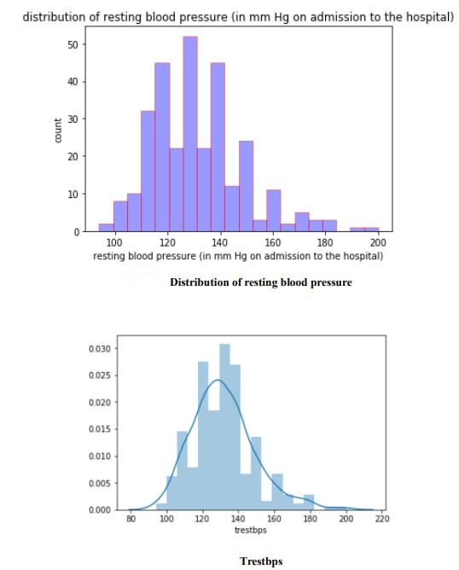
Distribution of resting blood pressure:

Slide 80
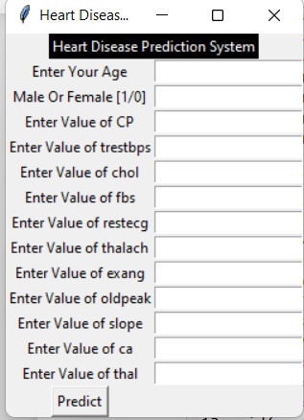
Result And Discussion: INPUT AND OUTPUT GUI
Here we are going to create and Predict the patients details through GUI for our project. So, anyone can perform predictions using this GUI.
INPUT:

Slide 81
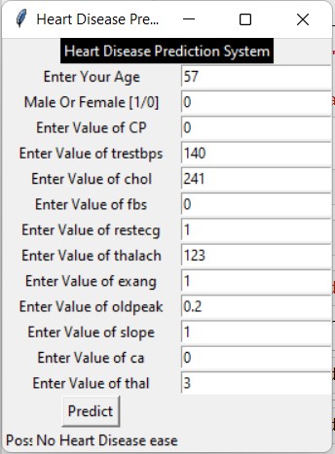
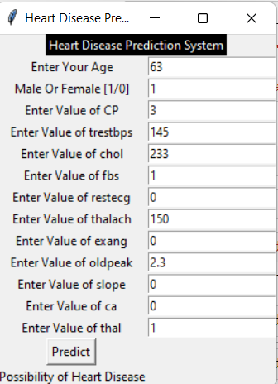
OUTPUT

Slide 82
RESULTS :
After the performing of machine learning Algorithms approach for training and testing we find that accuracy of the Random Forest is better compared to other algorithms. Accuracy Results is calculated with the support of the confusion matrix of each algorithm, here the number count of TP, TN, FP, FN has been given and using the equation of accuracy, value has been calculated and it is concluded that extreme gradient boosting is best with 95.08% accuracy and the comparison is shown below.
TABLE: Accuracy comparison of algorithms Algorithm Accuracy
Algorithms | Accuracy %
Logistic Regression | 85.25%
Naïve Bayes | 85.25%
SVM | 81.97%
K-Nearest Neighbors | 67.21%
Decision Tree | 81.97%
Random Forest | 95.08%
XG-Boost | 85.25%
Neural Network | 80.33%
Ada-Boost | 73.6%

Slide 83
CONCLUSION AND FUTURE WORK:
CONCLUSION:
• Heart diseases is a major silent killer in the India and throughout the world, and it’s the application of promising technology like machine learning algorithms is to be the initial prediction system of heart diseases will be to a profound impact on society. The early prognosis of heart disease can be aid in making decisions of lifestyle changes in a high-risk patients and in turn reduce the complications, which can be a great milestone in the field of medicine. The number of people facing heart diseases is on a raise every year. This prompts for its early diagnosis and treatment also. The utilization of suitable technology support in this regard can be prove to be highly beneficial to the medical fraternity and patients. In this paper, the eleven different machine learning algorithms used to measure the performance are SVM, Decision Tree, Random Forest, Naïve Bayes, Logistic Regression, Adaptive Boosting, and XG Boost ANN , KNN, Linear Regression, DNN Extreme gradient boosting are applied on the dataset. The expected attributes leading to heart disease in patients are available in the dataset which contains 76 features and 14 important features that are useful to evaluate the system are selected among them. If all the features taken into the consideration, then the efficiency of the system the author gets is less. To increase are efficiency, attribute selection is done. In this n features have to be selected for evaluating the model which are gives more accuracy results. In this The correlation method of some features in the dataset is almost equal and so they are removed. If all the attributes dataset present in the dataset are taken into account, then the efficiency decreases considerably. All the Eleven machine learning methods accuracies are compared based on which one prediction model is generated. Hence, the aim is to be use various evaluation metrics like confusion matrix, accuracy, precision, recall, and f1-score which predicts the disease efficiently. Comparing all Eleven the extreme gradient boosting classifier gives the highest accuracy of 95.08%
FUTURE WORK :
The work done here trains the system with a limited number of datasets. The machine learning algorithms become more accurate once they are fed with a huge number of data sets. So, this system can be trained with a huge number of data sets that would increase the accuracy in predicting the heart diseases. The analysis part of the system is done, and in order to be more useful can be integrated with electronic systems which give the system real-time inputs and would help the patient get the results then and there. There are multiple combinations of algorithms that can be tested against these data sets in order to yield better results.
For the Future Scope more machine learning approach will be used for best analysis of the heart diseases and for earlier prediction of diseases so that the rate of the death cases can be minimized by the awareness regarding the diseases. The analysis part of the system is done, and to be more useful can be integrated with electronic systems which give the system real-time inputs and would help the patient get the results then and there. There are multiple combinations of algorithms that can be tested against these data sets in order to yield better results.

Slide 84
REFERENCES:
[1] Amines Hazra, Arkomita Mukherjee, Amit Gupta, Asmita Mukherjee, “Heart Disease Prediction Using Machine Learning and Data Mining Techniques: A Review”, Research Gate Publications, July 2017, pp.2137-2149.
[2] V. Krishnaiah, Narsimha, Heart Disease Prediction System using Machine learning Techniques and it is utilizing the Intelligent of The Fuzzy Approach methods way in a Review paper International Journal based paper of Computer are Applied in Applications, 14 February 2017
[3] Guizhou Hu, Martin M. Root, "Building heart disease Prediction Models for Coronary artery Heart Disease by Synthesizing Multiple Longitudinal Research Findings”, European Science of Cardiology, 11 May 2005.
[4] Mythili, Dev Mukherji, Nikita Padilla and Abhi ram Naidu, “A Heart Disease Prediction Model using SVM- Decision Trees- Logistic Regression (SDL)”,International Journal of Computer Applications, vol.68,15 April 2013
[5] Nimai Chand Das Adhikari, Arpana Alka, and Rajat Garg, “HPPS: Heart disease Problem Prediction System using Machine Learning”.
[6] K. Polaraju, D. Durga Prasad, “Heart Disease Predication of using Multiple Linear Regression Model", International Journal of Engineering Development and Research Development, ISSN:2322-9939, 2017.
[7] Marjia Sultana, Afrin Haider, “Heart Disease Prediction model using WEKA tool and 10-Fold cross-validation”, The Institute of Electrical and Electronics Engineers, 18 March 2017.
[8] Dr.S.Seema Shedole, Kumari Deepika, “Predictive analytics to prevent and control chronic of heart disease”, https://www.researchgate.net/punlication/316530781,January 2016.
[9] Ashok kumar Dwivedi, “To Evaluate the performance of different types of machine learning techniques for prediction of heart disease using ten-fold And cross-validation 16 September 2016.
[10] Megha Shahi, R. Kaur Gurm, “Heart Disease Prediction System using Data Mining Techniques and Machine Learning Algorithms Techniques ”, Orient J. Computer Science Technology, vol.5 2018, pp.467-466
[11] Purushottam, Prof. (Dr.) Kanak Saxena, Richa Sharma, “ The Efficient Problem of Heart Disease Prediction System”, 2017, pp.962-969

